Slide 1
Introducing Office UI Fabric
Amie Seisay
www.seisayitsolutions.com
amie@seisayitsolutions.com
@AmieSeisay

Slide 2
Thanks to our sponsors
Platinum
Gold
Bronze
Northern VA CodeCamp Spring 2016

Slide 3
Thanks to host sponsor
Northern VA CodeCamp Spring 2016

Slide 4
Background
Skills
SharePoint Server Farm Architect
Developer
SharePoint Trainer
Credentials
Bachelors and Masters in Computer Science
MCTS, CTT+, ITIL
Company
Owner, Seisay IT Solutions
Clients
Federal Government
County Government
Associations
Medical
Insurance

Slide 5
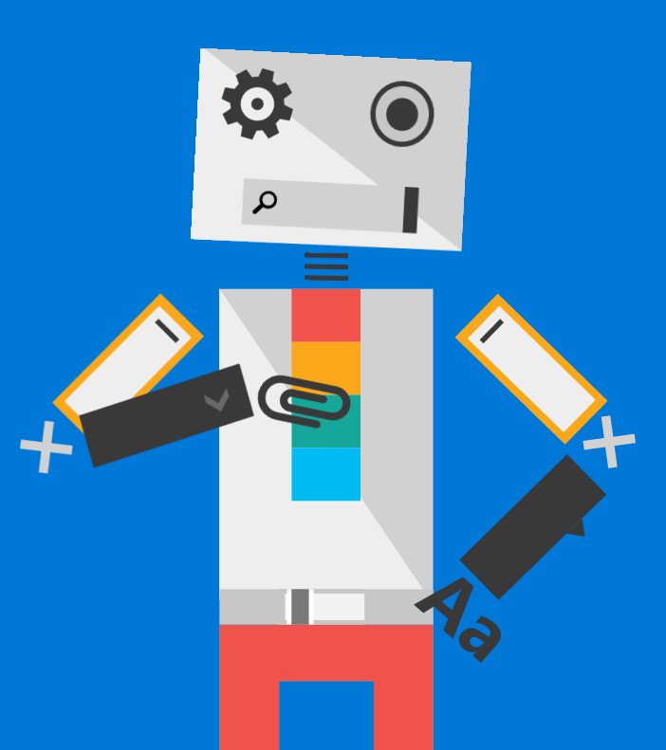
Intro to Office UI Fabric
Introduced in August 2015
Front end framework used for styling Office365 web apps and Office Add-ins
Consists of responsive, mobile friendly design components and styles
Based Office Design Language
@OfficeUIFabric

Slide 6
Getting started is easy!

Slide 7
Option 1 - Fabric CDN
Reference the Fabric CDN in the <head> section of your page
<link rel="stylesheet" href="http://appsforoffice.microsoft.com/fabric/2.1.0/fabric.min.css"> <link rel="stylesheet" href="http://appsforoffice.microsoft.com/fabric/2.1.0/fabric.components.min.css">

Slide 8
Option 2 - Download
GitHub: https://github.com/OfficeDev/Office-UI-Fabric

Slide 9
Option 3 – Package Manager
Install with a Package Manager
Npm $ npm install office-ui-fabric
Bower $ bower install office-ui-fabric
NuGet Package Manager PM> Install-Package office-ui-fabric

Slide 10
Framework Features
Styles: http://dev.office.com/fabric/styles
Typography (size, weight, color)
Icons
Animations
Language Optimized Fonts
Responsive Grid

Slide 11
Framework Features
Components: http://dev.office.com/fabric/components
Breadcrumbs
Button
Dialog
People Picker
Spinner

Slide 12
Tools for Development
Flexible with the Editors you are already using
NotePad ++
SharePoint Designer
Visual Studio
Visual Code
And others…
Chrome Extension
Fabric Explorer

Slide 13
Demo and Build!
Let’s take a look at some samples
Next let’s build something together
That’s right! Pull out your laptops!!!

Slide 14
Resources
Office UI Fabric: http://dev.office.com/fabric
Office UI Fabric for iOS: http://dev.office.com/fabric/blog and https://github.com/OfficeDev/Office-UI-Fabric-iOS
Code Snippets and Fabric Explorer by David Mann: http://blog.mannsoftware.com/?p=2371

